Slide 1
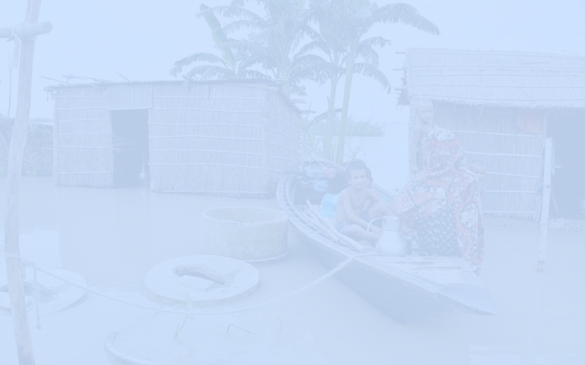


Presentation on
Disaster Relief Registration & Support Tracker
Submitted to:
Board of Examiners
Dr. Mohammad Shahidul Islam, PhD Supervisor
Institute of Information Technology
Jahangirnagar University
1.
Dr. Shamim Al Mamun
Professor, IIT, JU
Coordinator, PGDIT Coordination Committee
2.
Dr. Risala Tasnim Khan
Professor, IIT, JU
Director and Member, PGDIT Coordination Committee
Submitted by:
Prince Sarkar
ID: 24204
Batch: PGDIT, Summer 2024
Mohidul Hasan
ID: 24206
PGDIT, Summer 2024
3.
Dr. Mohammad Shahidul Islam
Professor, IIT, JU
Member, PGDIT Coordination Committee
8 August 2025

Slide 2

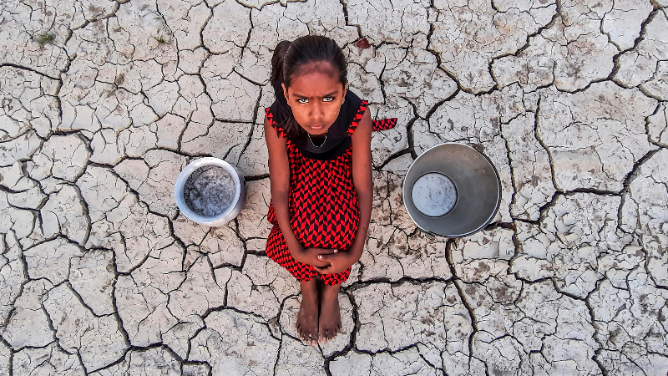
PROJECT OVERVIEW
Background
What Problem Are We Solving?
Bangladesh frequently faces natural disasters such as floods, cyclones, and river erosion.
Relief distribution during these emergencies is often manual, delayed, and lacks transparency.
This project presents a centralized digital solution using Oracle APEX & Oracle Database to register victims and track relief delivery efficiently.
Manual paperwork
leads to:
Duplication, Delays, Lack of accountability
No centralized system to register disaster-affected people in real-time.
Volunteers struggle to collect and manage data effectively.
Relief delivery often fails to meet actual on-ground needs.

Slide 3

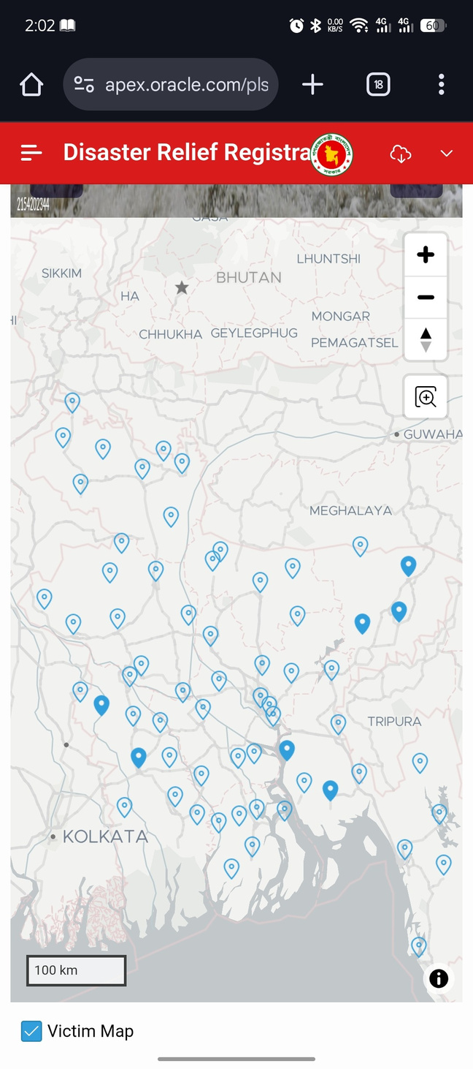
OBJECTIVES OF THIS PROJECT
01
Digitally register disaster-affected individuals on-site
02
Track item needs (food, clothing, hygiene kits, etc.)
03
Automatically generate delivery invoices and package lists
04
Assign supervisors to ensure confirmed delivery
05
Monitor shortages and trigger restock alerts
06
Visualize affected areas through interactive maps

Slide 4
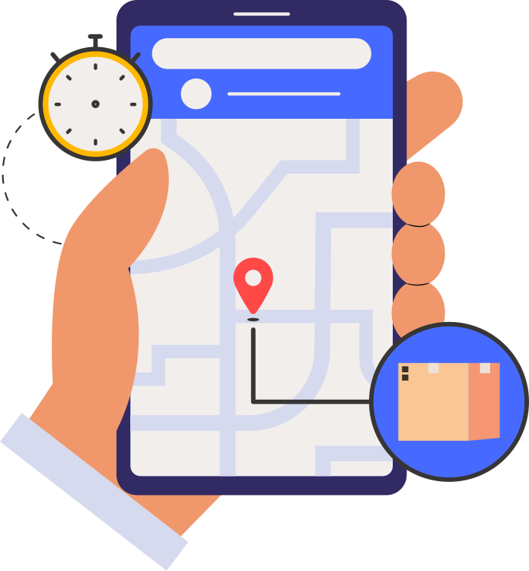




Why This System Matters
SCOPE OF THE PROJECT
Enables live tracking and mapping
Geographical Coverage: Nationwide (Bangladesh)
Users: Volunteers, Supervisors, Admin
Platform: Oracle APEX (Web-based)
Operations Included:
Supports data-driven relief allocation
Victim registration
Need assessment
Relief package generation
Delivery tracking
Inventory alerts
Minimizes errors and accelerates response
Ensures all victims are recorded
Not included: Real-time mobile app (planned for future)
Centralized platform for organization

Slide 5

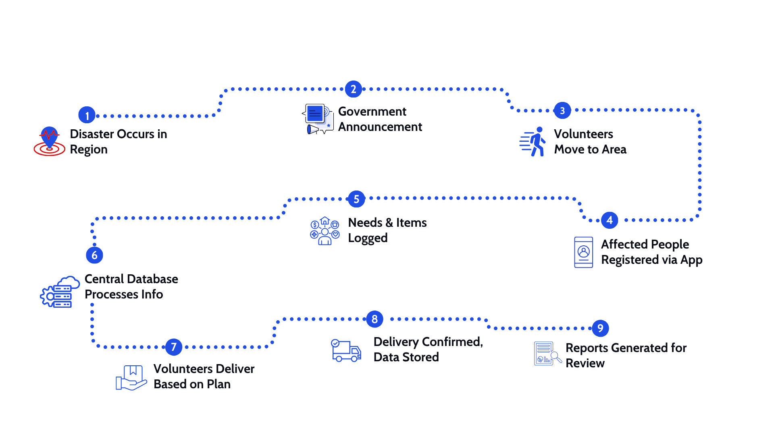
System Overview

Slide 6
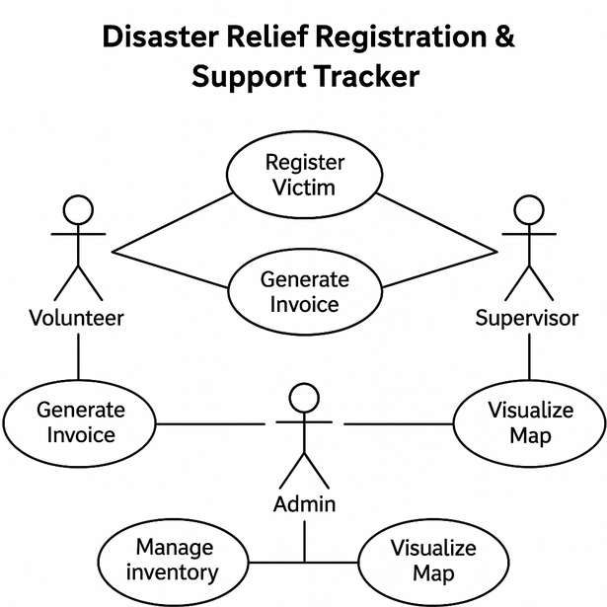
System Users & Permissions
User Type | Access & Actions
Volunteer | Register victims, input needs, update location
Supervisor | Receive invoices, manage delivery, mark completed
Admin | Monitor full system, approve users, manage data
Use case diagram
Link: http://apex.oracle.com/pls/apex/f?p=61713

Slide 7

Functional Requirements
Non-Functional Requirements
Victim registration with GPS & NID
Store & retrieve affected people’s data
Record requested relief items
Assign delivery roles
Detect item shortage automatically
Visualize affected areas on map
Export data for government/NGOs
Secure & authenticated user access
Mobile responsiveness (Oracle APEX)
Real-time data synchronization
Optimized for low-bandwidth regions
Scalable to national level
Oracle DB reliability and integrity
Link: http://apex.oracle.com/pls/apex/f?p=61713

Slide 8
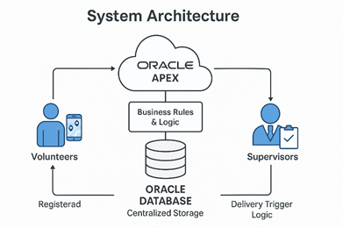
System Architecture Overview
Category | Technology
Front-End | Oracle APEX (Web UI)
Back-End | Oracle Database (SQL/PLSQL)
Logic & Triggers | PL/SQL Procedures & Triggers
Mapping | APEX Map Plugin / Leaflet.js
Hosting/Infra | Local Oracle DB / Cloud (optional)
Security | Role-based login, NID validation
Link: http://apex.oracle.com/pls/apex/f?p=61713

Slide 9
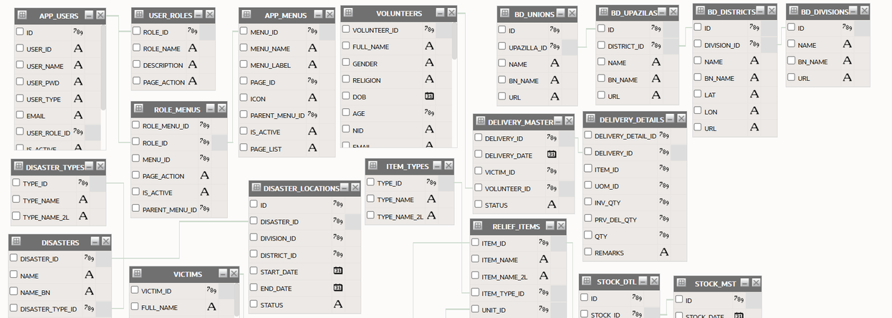
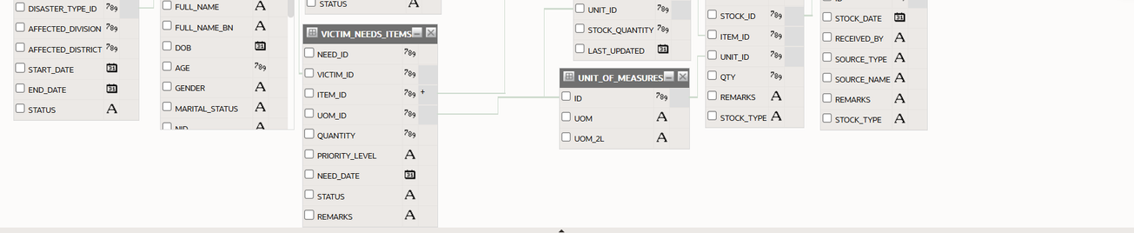
Database Tables Overview
Table Name | Description
Affected_People | Stores victim info, GPS, NID, region
Relief_Items | Available item types & quantities
Volunteer | Registered volunteers with contact info
Supervisor | Supervisors responsible for delivery
Delivery_Log | Tracks what is delivered and when
Relief_Request | Items requested by a registered victim
Entity Relationship Diagram (ERD)
Link: http://apex.oracle.com/pls/apex/f?p=61713

Slide 10
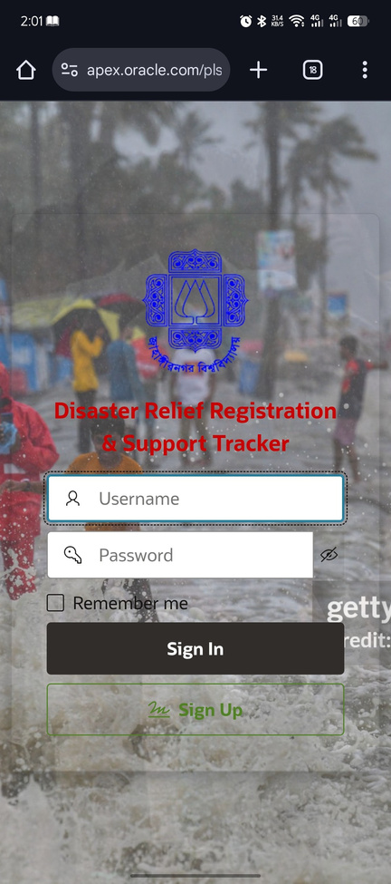
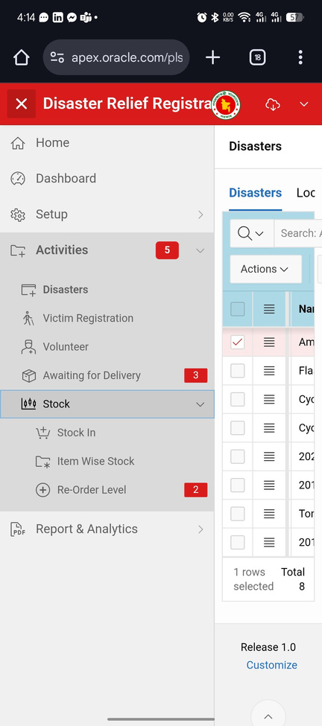
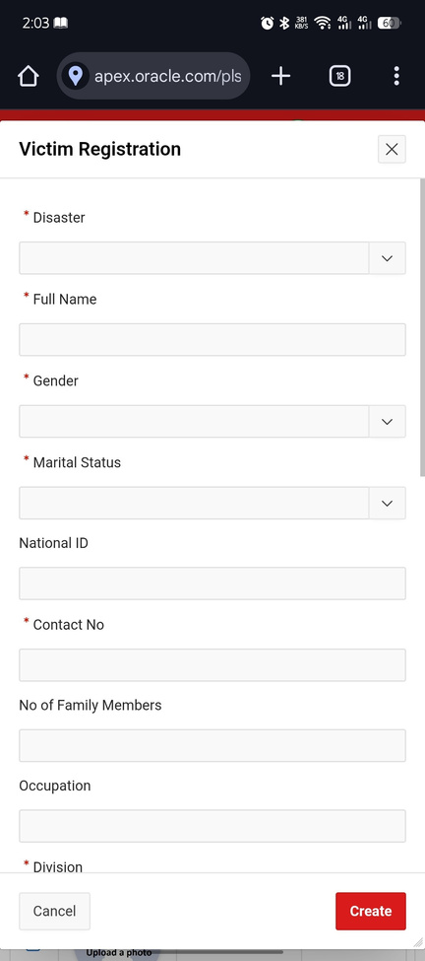
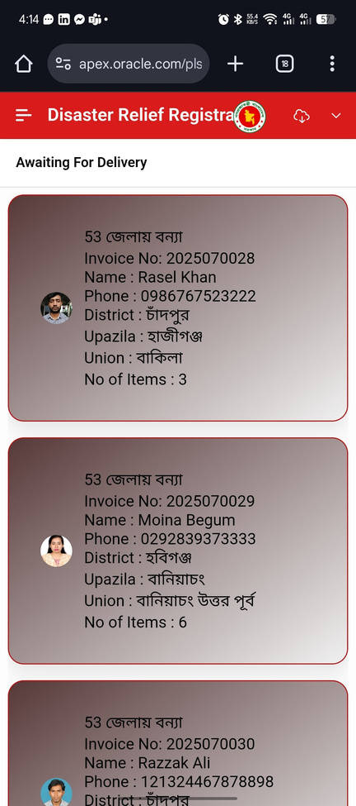
USER INTERFACE (ORACLE APEX)
Login page
Interactive map
Menu list
Victim registration
Delivery list
Link: http://apex.oracle.com/pls/apex/f?p=61713

Slide 11
MANUAL VS. DIGITAL SYSTEM COMPARISON
Feature | Manual Process | Our System
Victim Registration | Paper forms, delayed | Instant via mobile APEX interface
Data Storage | Physical records | Centralized Oracle DB
Relief Distribution Tracking | Manual reporting | Automated with live tracking
Map Visualization | Not available | Integrated mapping with GPS
Inventory Alerts | Often missed | Trigger-based notifications
Supervisor Assignment | Manually coordinated | Automated by system logic
Link: http://apex.oracle.com/pls/apex/f?p=61713

Slide 12
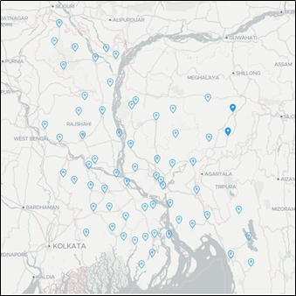
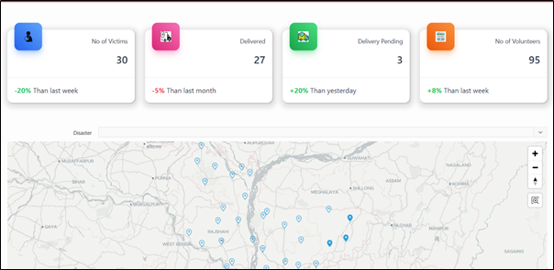


MAPPING & DELIVERY VISUALIZATION
Covered Blue = Requesting Items
Inventory Dashboard
Covered Blue = Disaster Area
Link: http://apex.oracle.com/pls/apex/f?p=61713

Slide 13
SUMMARY & WHAT WE ACCOMPLISHED
Designed and implemented a disaster registration & support system
Built on Oracle APEX with centralized Oracle DB •
Delivered core features:
•
Ensured scalability, transparency, and responsiveness
Real-time registration
Relief tracking
Inventory logic
GIS mapping
Link: http://apex.oracle.com/pls/apex/f?p=61713

Slide 14







FUTURE IMPROVEMENTS
Mobile App (Android/iOS) for volunteers
SMS/OTP-based victim verification
Integration with national NID verification system
Disaster heatmap & real-time analytics dashboard
Government & NGO data export features
Cloud deployment via Oracle Cloud Infrastructure
Link: http://apex.oracle.com/pls/apex/f?p=61713

Slide 15

THANK YOU!
For your attention
Prince Sarkar & Mohidul Hasan | August 2025

